Slide 1

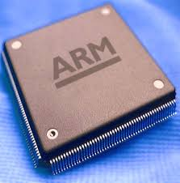
Microprocessors & Computer Architecture
UE18CS253
Unit-1
Session – 6
ARM
Assembly Language Programming
Credits:
MPCA Team
SESSION JAN-MAY 2020
1
Notes:
1

Slide 2
The ARM
Multiplication Instructions
SESSION JAN-MAY 2020
2

Slide 3
Multiplication
MUL R0, R1, R2
@ R0 = (R1xR2)_{[31:0]}
Features:
Second operand can’t be immediate
The result register must be different from the first operand
Cycles depends on core type
If S bit is set, C flag is meaningless
SESSION JAN-MAY 2020
3

Slide 4
Multiplication
Multiply-accumulate (2D array indexing)
MLA R4, R3, R2, R1 @ R4 = R3xR2+R1
Multiply with a constant can often be more efficiently implemented using shifted register operand.
MOV R1, #35
MUL R2, R0, R1
or
ADD R0, R0, R0, LSL #2 @ R0’=5xR0
RSB R2, R0, R0, LSL #3 @ R2 =7xR0’
SESSION JAN-MAY 2020
4

Slide 5
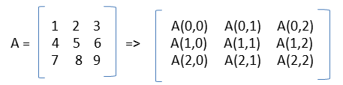
MLA Example:
Matrix Representation in memory
CODE
1
00000000
Row Major Order for a 3 x 3 matrix :
A [ 2, 2] = Row Num. x No. of elements per row + Column Num.
2 x 3 + 2 = 8th location.
Since each location is of 4 bytes, the address of the 3rd element in the 2nd row is 8 x 4 = 32.
This is achieved in ARM processor, using MLA instruction as follows.
MLA R1, R2, R3, R4
Mnemonic
R1: Dst ; R2: Row #
R3: # of elements per row ; R4: col #
To get consecutive data elements in a @D Array.
2
00000001
3
4
5
6
7
8
9
00000020
SESSION JAN-MAY 2020
5

Slide 6
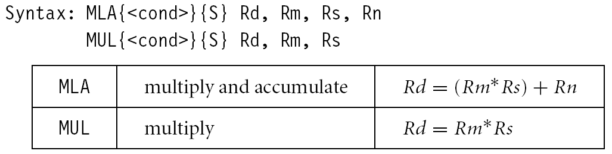
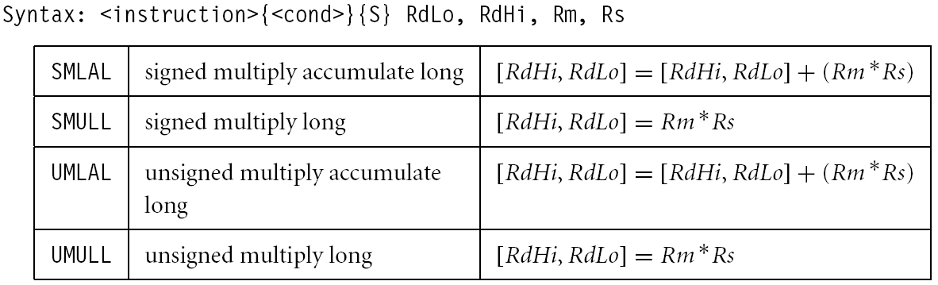
Multiplication
CODE
SESSION JAN-MAY 2020
6

Slide 7
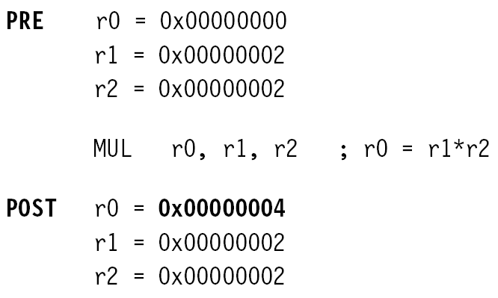
Multiplication – Example 1
SESSION JAN-MAY 2020
7

Slide 8
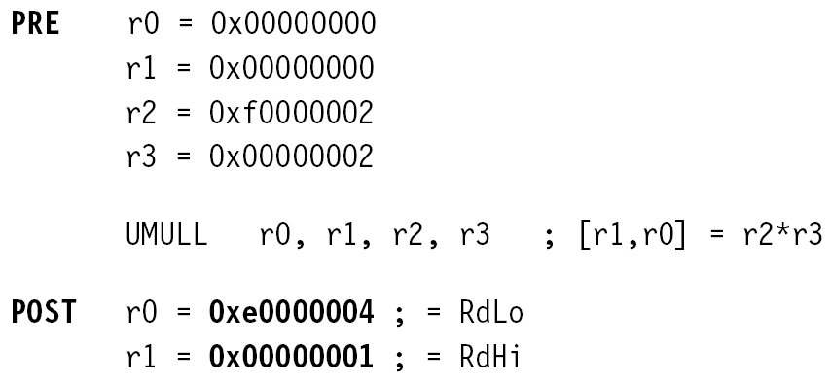
Multiplication Example 2
SESSION JAN-MAY 2020
8

Slide 9
The ARM
Conditional Execution
SESSION JAN-MAY 2020
9

Slide 10
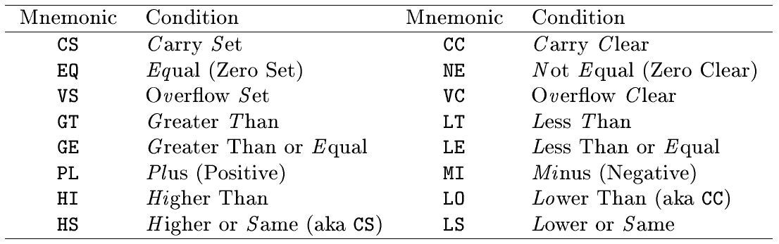
Conditional Execution
CODE
Almost all ARM instructions have a condition field which allows it to be executed conditionally.
MOVCS R0, R1
SESSION JAN-MAY 2020
10
Notes:
10

Slide 11
Conditional Execution
CMP R0, #5
BEQ bypass @ if (R0!=5) {
ADD R1, R1, R0 @ R1=R1+R0-R2
SUB R1, R1, R2 @ }
bypass: …
CMP R0, #5
ADDNE R1, R1, R0
SUBNE R1, R1, R2
; smaller and faster
Rule of thumb: if the conditional sequence is three instructions
or less, it is better to use conditional execution than a branch.
SESSION JAN-MAY 2020
11

Slide 12
Conditional Execution
if ((R0==R1) && (R2==R3)) R4++
CMP R0, R1
BNE skip
CMP R2, R3
BNE skip
ADD R4, R4, #1
skip: …
CMP R0, R1
CMPEQ R2, R3
ADDEQ R4, R4, #1
SESSION JAN-MAY 2020
12

Slide 13
The ARM
Multiple Load / Store Instructions
SESSION JAN-MAY 2020
13

Slide 14
Multiple register load/store
Transfer a block of data more efficiently.
Used for procedure entry and exit for saving and restoring workspace registers and the return address
For ARM7, 2+Nt cycles
(N: #words, t: time for a word for sequential access).
Increase interrupt latency since it can’t be
interrupted.
registers are arranged an in increasing order;
LDMIA R1, {R0, R2, R5} @ R0 = mem[R1]
@ R2 = mem[R1+4]
@ R5 = mem[R1+8]
SESSION JAN-MAY 2020
14

Slide 15
Multiple load/store register
LDM load multiple registers
STM store multiple registers
suffix meaning
IA increase after
IB increase before
DA decrease after
DB decrease before
SESSION JAN-MAY 2020
15
Notes:
15

Slide 16
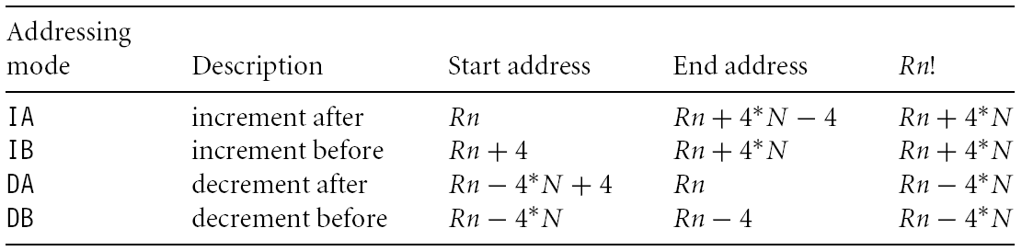
Addressing modes – Multiple
CODE
SESSION JAN-MAY 2020
16

Slide 17
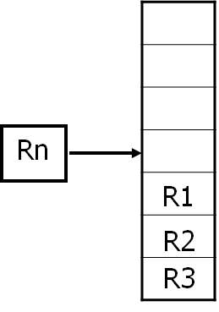
Multiple load/store register
LDM<mode> Rn, {<registers>}
IA: addr:=Rn
IB: addr:=Rn+4
DA: addr:=Rn-#<registers>*4+4
DB: addr:=Rn-#<registers>*4
For each Ri in <registers>
IB: addr:=addr+4
DB: addr:=addr-4
Ri:=M[addr]
IA: addr:=addr+4
DA: addr:=addr-4
<!>: Rn:=addr
SESSION JAN-MAY 2020
17
Notes:
17

Slide 18
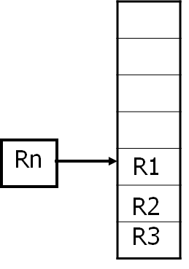
Multiple load/store register
LDM<mode> Rn, {<registers>}
IA: addr:=Rn
IB: addr:=Rn+4
DA: addr:=Rn-#<registers>*4+4
DB: addr:=Rn-#<registers>*4
For each Ri in <registers>
IB: addr:=addr+4
DB: addr:=addr-4
Ri:=M[addr]
IA: addr:=addr+4
DA: addr:=addr-4
<!>: Rn:=addr
SESSION JAN-MAY 2020
18
Notes:
18

Slide 19
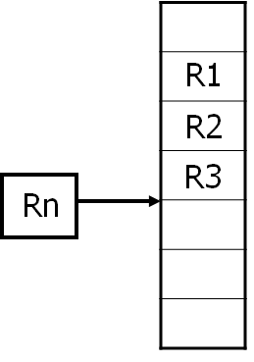
Multiple load/store register
LDM<mode> Rn, {<registers>}
IA: addr:=Rn
IB: addr:=Rn+4
DA: addr:=Rn-#<registers>*4+4
DB: addr:=Rn-#<registers>*4
For each Ri in <registers>
IB: addr:=addr+4
DB: addr:=addr-4
Ri:=M[addr]
IA: addr:=addr+4
DA: addr:=addr-4
<!>: Rn:=addr
SESSION JAN-MAY 2020
19
Notes:
19

Slide 20
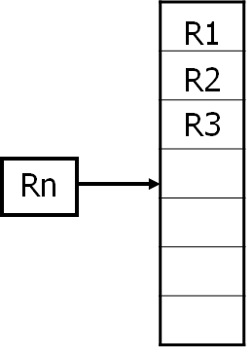
Multiple load/store register
LDM<mode> Rn, {<registers>}
IA: addr:=Rn
IB: addr:=Rn+4
DA: addr:=Rn-#<registers>*4+4
DB: addr:=Rn-#<registers>*4
For each Ri in <registers>
IB: addr:=addr+4
DB: addr:=addr-4
Ri:=M[addr]
IA: addr:=addr+4
DA: addr:=addr-4
<!>: Rn:=addr
SESSION JAN-MAY 2020
20
Notes:
20

Slide 21
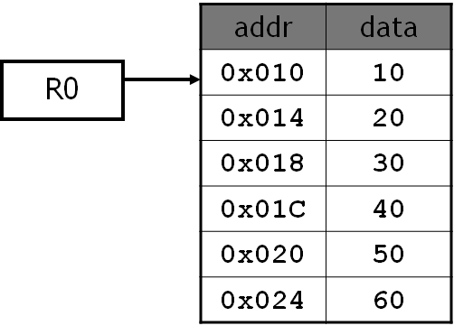
Multiple load/store register
CODE
LDMIA R0, {R1,R2,R3}
or
LDMIA R0, {R1-R3}
R1: 10
R2: 20
R3: 30
R0: 0x10
SESSION JAN-MAY 2020
21
Notes:
21

Slide 22
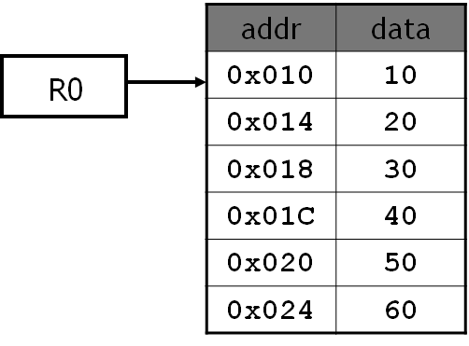
Multiple load/store register
CODE
LDMIA R0!, {R1,R2,R3}
R1: 10
R2: 20
R3: 30
R0: 0x01C
SESSION JAN-MAY 2020
22
Notes:
22

Slide 23
Multiple load/store register
CODE
LDMIB R0!, {R1,R2,R3}
R1: 20
R2: 30
R3: 40
R0: 0x01C
SESSION JAN-MAY 2020
23
Notes:
23

Slide 24
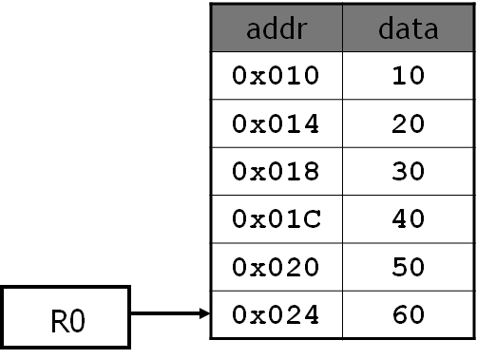
Multiple load/store register
CODE
LDMDA R0!, {R1,R2,R3}
R1: 40
R2: 50
R3: 60
R0: 0x018
SESSION JAN-MAY 2020
24
Notes:
24

Slide 25

Multiple load/store register
CODE
LDMDB R0!, {R1,R2,R3}
R1: 30
R2: 40
R3: 50
R0: 0x018
SESSION JAN-MAY 2020
25
Notes:
25

Slide 26

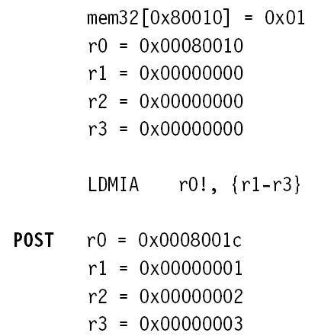
Example
SESSION JAN-MAY 2020
26

Slide 27
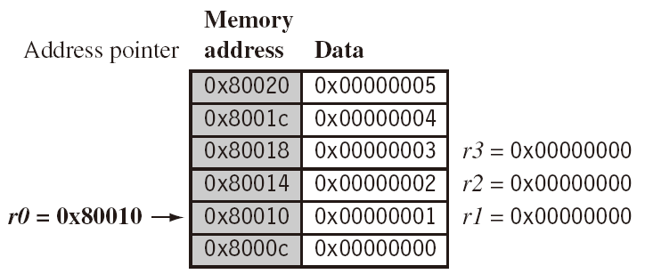
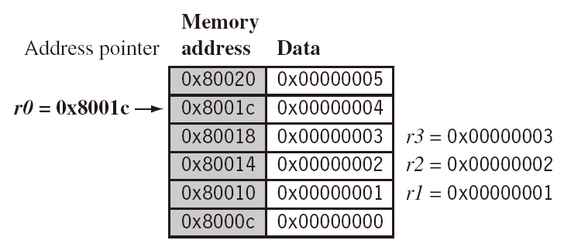
Example
LDMIA r0!, {r1-r3}
SESSION JAN-MAY 2020
27

Slide 28
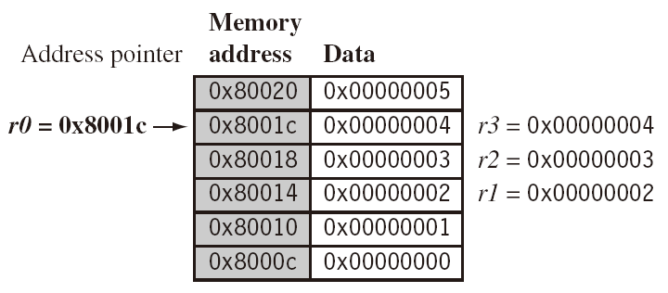
Example
LDMIB r0!, {r1-r3}
SESSION JAN-MAY 2020
28

Slide 29
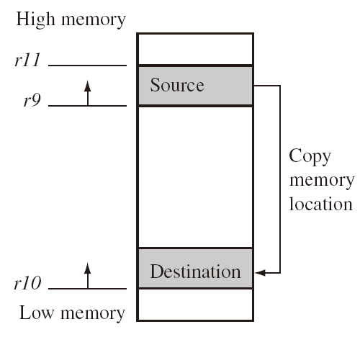
Application
CODE
Copy a block of memory
R9: address of the source
R10: address of the destination
R11: end address of the source
loop: LDMIA R9!, {R0-R7}
STMIA R10!, {R0-R7}
CMP R9, R11
BNE loop
SESSION JAN-MAY 2020
29

Slide 30
Application
Stack
(full: pointing to the last used; ascending: grow towards increasing memory addresses)
LDMFD R13!, {R2-R9} @ used for ATPCS
… @ modify R2-R9
STMFD R13!, {R2-R9}
mode | POP | =LDM | PUSH | =STM
Full ascending (FA) | LDMFA | LDMDA | STMFA | STMIB
Full descending (FD) | LDMFD | LDMIA | STMFD | STMDB
Empty ascending (EA) | LDMEA | LDMDB | STMEA | STMIA
Empty descending (ED) | LDMED | LDMIB | STMED | STMDA
SESSION JAN-MAY 2020
30

Slide 31
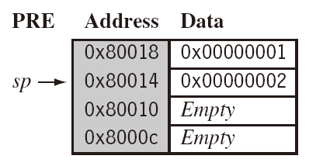

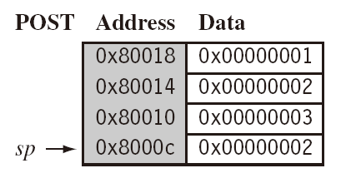
Example
SESSION JAN-MAY 2020
31

Slide 32
Q & A on Arm Instruction Set Conditional Execution & Multiple Load / Store Instructions
SESSION JAN-MAY 2020
32
Notes:
32

